Slide 1
UN – The United Nations

Slide 2
When, and Why?
When: April 25, 1945
Why: It was one of the allies’ goals during WWII to create an international organization to ensure global collective security.

Slide 3
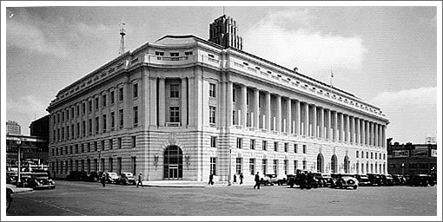
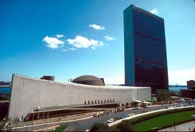
Where?
San Francisco, California
Present Day – New York City

Slide 4
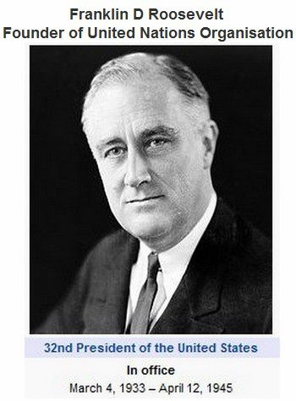
Who?
He was determined to make the United Nations a strong organization by ensuring that all major powers be involved.

Slide 5
It’s Main Purpose (3.3.1)
Maintain international peace & settle disputes
Develop equal rights & national self determination
Solve social, economic & humanitarian problems

Slide 6
Some of it’s basic Principles are:
The equality of all members
All members fulfill its UN obligations
Settle disputes peacefully
Refrain the use of force against any state
Help the UN in any action it undertakes

Slide 7
Why did the League of Nations fail?

Slide 8
Answer:
The League of Nations had been too weak to stop aggression because major powers were unwilling to give up their self interest to such an international organization.

Slide 9
Challenges faced by the UN
The main problem was how to accommodate the national self interest of large & small powers.
What was needed was a formula that would give major powers a greater role in the United Nations while still recognizing the need of all countries to have a voice.

Slide 10
Answer!!!!!
To ensure American commitment the headquarters was put in the United States.
To divide the UN into TWO parts:

Slide 11
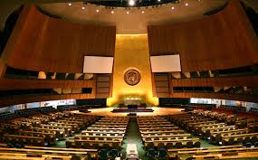
1. General Assembly:
All members met in the assembly to present their positions on issues.
Each country has 1 VOTE ( most decisions are reached by a simple majority)
On questions of peace or expulsion of a member, a majority of 2/3's is required.
Critics say the General Assembly is an ineffective “talk shop” where nations simply play politics.

Slide 12
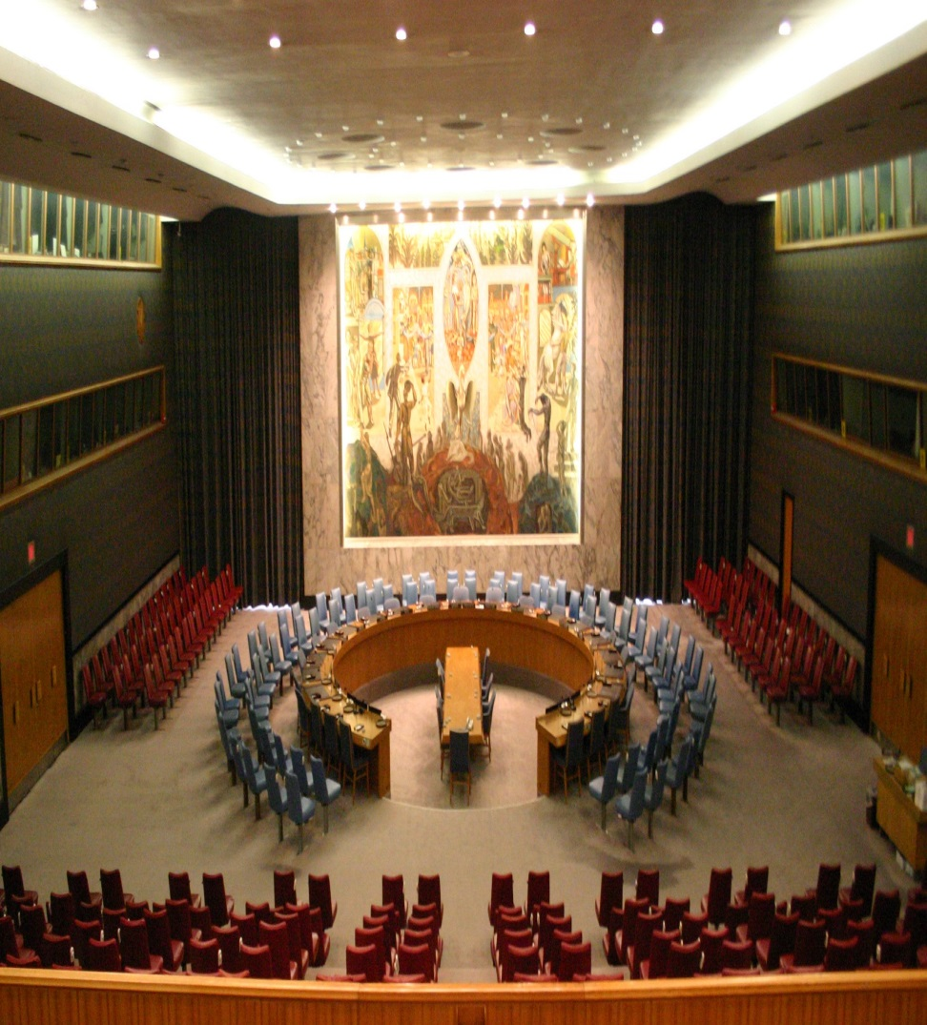
2. Security Council:
The real power behind the UN is the Security Council, which is made up of TWO groups:
Five permanent members: China, France, Britain, Russia and the United States. Permanent members have veto power which is the right to stop any UN action.
Ten non-permanent members: elected for two year terms
The major responsibility of the Security Council is to maintain peace and security.

Slide 13
Note:
It can order a ceasefire, impose economic sanctions and authorize the use of military force against an aggressor.
Critics point out that the VETO power of the permanent members is a weakness of the UN.

Slide 14
They argue that countries will use the veto to block any UN action that is not in their self interest.
During the Cold War the Security Council was often deadlocked as the U.S. and Soviets often used the veto against each other.

Slide 15
It must be pointed out that the veto power ensured the continuing commitment of all major powers and that there has been no large scale wars since its creation.

Slide 16
4.2.1 Terms:
Uniting for Peace Resolution:
U.N. resolution that gave the General Assembly power to deal with issues of international aggression if the Security Council is deadlocked.
Veto:
The right to reject a proposal or forbid an action.

Slide 17
4.2.3 Korea: Containment or UN
What were the (a) underlying causes and (b) immediate causes of the Korean War?
How did the U.N. become involved in the Korean War?
Was the Korean War more a U.N. or U.S. military action (Fig.6.5 page 172)?
What was the outcome of the conflict?
Was the Korean War American containment or U.N. peacekeeping?

Slide 18
6.1.1 Terms:
Human Rights:
The freedom granted to all people protecting them from unlawful arrest, torture, or execution.

Slide 19
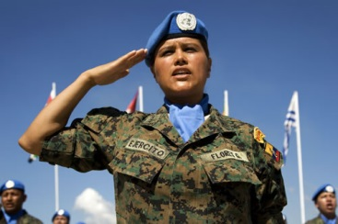
6.1.2 Peacekeeping Roles
THREE peacekeeping roles that UN forces are sometimes called upon to perform in trouble areas of the world:
Mediation of disputes between conflicting parties.
Deployment of military forces to maintain peace in civil or international wars.
Deployment of military forces to ensure distribution of humanitarian aid.

Slide 20
6.1.3 Examples of Peacekeeping

Slide 21
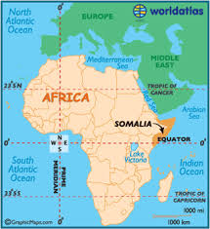
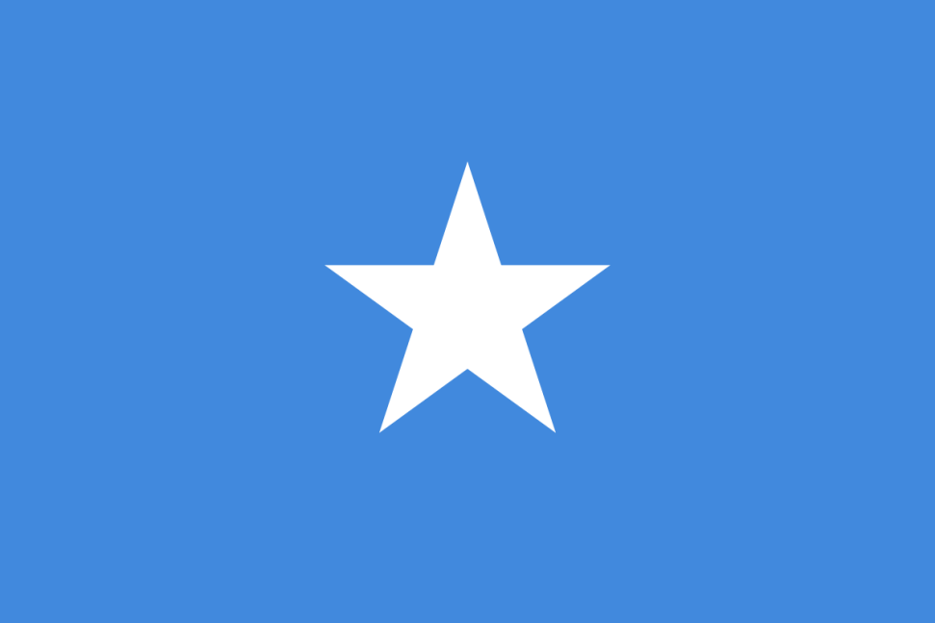
1. Somalia:

Slide 22
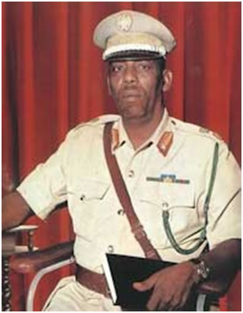
Background:
The Republic of Somalia (Africa) was created in 1960; 9 years later there was a military coup.
For the next 20 years under the rule of a dictator (General Barre) democracy was eliminated, industries were nationalized, and human rights were abused.

Slide 23
In 1988 civil war broke out in the drought stricken country as Somali clans opposed Barre
By 1991 Barre had control of Northern Somalia but WARLORDS competed for political power in the South.

Slide 24
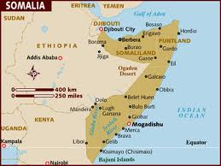
Part of Mogadishu, in the South, was divided between Abgall (5000 guerillas) and Aidid (10,000 guerillas).
Famine spread throughout Somalia and 300,000 to 500,000 people died.

Slide 25
UN Involvement

Slide 26
Thousands fled to Mogadishu but the warlords controlled the FOOD (supplied by UN) only giving it to people who supported them.
These warlords also opposed the idea of UN military forces entering the country.
Despite the best efforts of groups like UNICEF and Red Cross food destined for famine victims continued to be looted and used by those engaged on the civil war.

Slide 27
By June 1992, 6 million faced starvation.
In 1992, with Operation Restore Hope, the UN authorized the use of military force to ensure food reached the people of Somalia.
In December a U.S. led operation arrived in Somalia which put UN soldiers in direct confrontation with the warring factions.

Slide 28
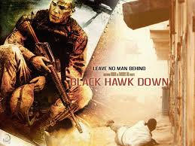
Black Hawk Down (2001)
In 1993 18 U.S. soldiers were killed and dragged through the streets of Mogadishu.
Movie Trailer
As a result the UN mission in Somalia changed from humanitarian aid to demobilizing warring factions.

Slide 29
Thousands died in clashes including dozens of peacekeepers.
The UN was unable to maintain a cease fire, and so the mission ended in failure.
UN troops were withdrawn in March 1995.*
By 2000 the UN had set up a Transitional National Government to draw a constitution and hold elections.

Slide 30
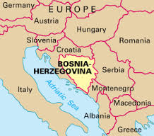
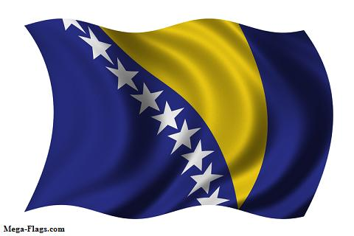
2. Bosnia-Herzegovina (Yugloslavia)

Slide 31
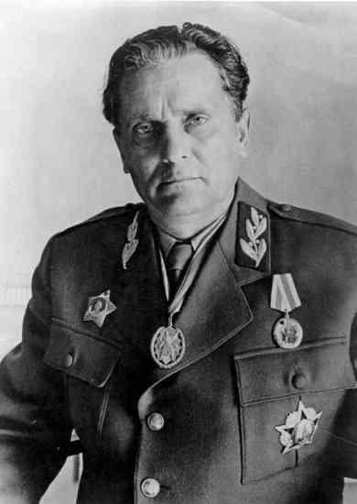
Background:
Josef Broz Tito ruled Yugoslavia from 1945 to 1980.
Under Tito the country made up of SIX republics: Bosnia, Croatia, Macedonia, Montenegro, Slovenia and Serbia were prosperous, peaceful and independent.
By 1990 the country had broken apart into competing ethnic and political groups.

Slide 32
Yugoslavia’s breakup became a reality in June 1991 when Croatia and Slovenia separated from Yugoslavia and declared themselves independent.
The Serbian - dominated Yugoslav army attempted to prevent the separations but failed.
Fighting raged throughout 1991 resulting in the deaths of thousands.

Slide 33
By the end of 1991 it was clear that the Serbia had failed to prevent the disintegration of Yugoslavia.
The Serbs were now determined to prevent the separation of Bosnia-Herzegovina.

Slide 34
The population of Bosnia was 44% Muslim, 31% Serbian and 17% Croatian, the remainder being other ethnic groups.
The Muslims and Croats voted in favour of independence in 1992.

Slide 35
Serbia, unwilling to see the largest group of Serbs outside Serbia become a minority, within a new country, launched a full scale assault on Bosnia in an attempt to eliminate ALL Muslims and Croats.
People were driven out of their homes, and houses were burned down to prevent the return Muslims or Croats.

Slide 36
This policy of forcing ethnic groups out of a region became known as ETHENIC CLEANSING.
The situation in the former Yugoslavia soon attracted world attention and intervention.

Slide 37
UN Involvement

Slide 38
The UN demanded an end to the violence BUT was ignored.
The UN imposed harsh ECONOMIC SANCTIONS against Serbia and sent UN peacekeeping forces to Bosnia to protect the airport to protect relief shipments.
However these forces did not have the ability to impose peace.

Slide 39
Fighting continued throughout 1992 and by 1993 Serbia was expelled from the UN.
UN peacekeeping forces were now threatened.

Slide 40
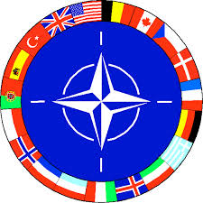
Results:
Finally the U.S. was able to convince NATO to intervene militarily.
In the end the region became a confusing mix of NATO peacemaking and UN peacekeeping– both failed to provide a lasting peace.
The Serbs would be defeated in 1999 by NATO when they invaded Kosovo.

Slide 41
Behind Enemy Lines (2001)
Movie Trailer

