Slide 1
Almost there!!!!!

Slide 2
Unit 5
End of Colonialism (Africa, and India)

Slide 3
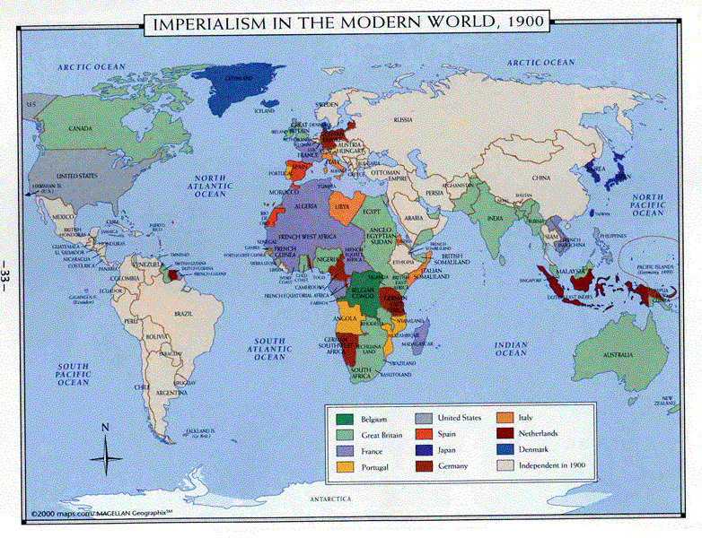
1.1.2 Imperialist Nations of the World

Slide 4
Why Imperialism in 1900’s???

Slide 5
5.1.4 Why did it end?
The end of W.W.II signaled the decline and eventual end of the European COLONIAL empires.
NATIONALISM spread throughout colonies and eventually one by one they gained INDEPENDENCE.

Slide 6
FACTORS led to the decline of colonialism:

Slide 7
1. Atlantic Charter
Promoted sovereignty and self government for ALL nations.
This encouraged Nationalists in colonies to fight for independence.

Slide 8
2. Colonial Nationalist movements:
Grew in the colonies.
Ironically, the leaders of these groups were trained in Western ideas at Universities such as France, Britain and other Western countries.
These people returned home to emerge as the leaders of Nationalist groups that fought for Independence. (ex. Gandhi)

Slide 9
3. Europe Supported Independence:
Because of the high COST of maintaining them.
European powers were unable to justify holding these colonies when their economies were struggling following 6 years of war.

Slide 10
4. Superpowers Demanded it:
Following W.W.II both the U.S. and U.S.S.R wanted to see the breakup of the European empires.
The U.S. having waged a war of Independence against Britain (1776) supported independence movements.
The U.S. also felt if Europe lost its empires they would have greater access to colonial markets.
The Soviets opposed European empires feeling that if the empires collapsed there were be greater opportunities for establishing Communist countries.

Slide 11
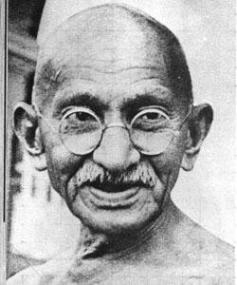
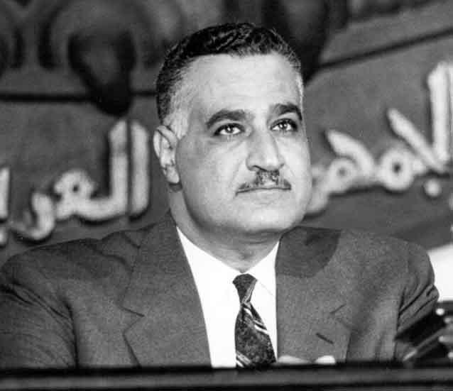
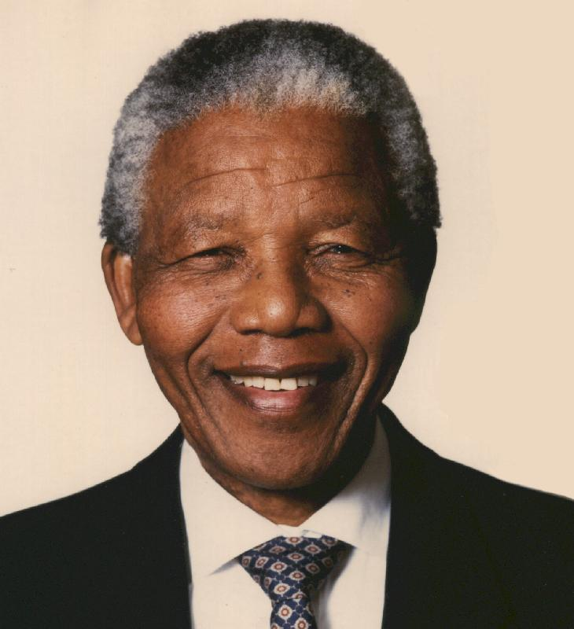
Nelson Mandela
Gamel Abdel Nasser
Mohandas Gandhi

Slide 12
5.1.5 – 5.1.6 Examples
Gandhi in India (Chapter 10)
Nasser in Egypt (Chapter 6 – UN)
Mandela in South Africa (Chapter 9)

Slide 13
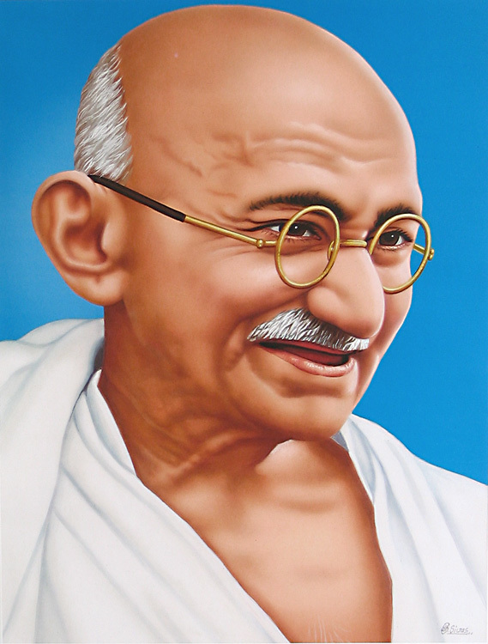
1. Gandhi: 1869 - 1948
For 200 years Britain ruled India and did not want to give up this valuable colony.
GANDHI, trained as a lawyer in Britain, returned to India in 1915 to lead India’s struggle to Independence.
The methods Gandhi used to achieve independence were NON-VIOLENCE and CIVIL DISOBEDIENCE.

Slide 14
Gandhi believed that Indian people had the right to freedom and self rule.
Because Britain deprived India of its independence, Gandhi felt they should resist or break British law.

Slide 15
How???
Gandhi thus encouraged Indian people to refuse to obey morally intolerable laws (SALT TAX).
This is civil disobedience.

Slide 16
Taxation of salt has occurred in India since the earliest times.
However, this tax was greatly increased when the British East India Company began to establish its rule over provinces in India.
In 1835, special taxes were imposed on Indian salt to facilitate its import.
This paid huge dividends for the traders of the British East India Company.
When the Crown took over the administration of India from the Company in 1858, the taxes were not replaced.

Slide 17
Some examples of Civil Disobedience were:
Resign from Government jobs.
Stop buying British goods.
Refuse to pay taxes.
Purposely break unfair laws.

Slide 18
Gandhi insisted that his followers NOT respond to the British with violence.
If Indians were protesting and police clubbed them, Gandhi insisted that they not only not hit back but not even shield themselves from the attack.
This was non-violence.

Slide 19
Gandhi believed that the British would be defeated not when they had any strength but when they had no heart to fight against a moral, non-violent people.
Gandhi’s methods were eventually successful and India became independent in 1947.

Slide 20
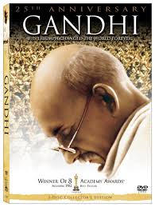
Gandhi - 1982
Movie Trailer

Slide 21
2. Nasser (Egypt)
Egyptian Nationalism increased the growing criticism of Egypt’s monarchy as corrupt.
Egypt’s defeat by Israel in 1948 caused humiliation among Egyptian soldiers.
Pledging to restore Arab pride, Nasser and others formed a FREE OFFICERS MOVEMENT aimed at driving out foreign powers.
In 1952, army officers forced the Egyptian King FAROUK to abdicate.

Slide 22
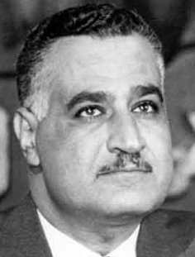
The monarchy was abolished and a new republic, with NASSER as President, was established in 1956.
Nasser was celebrated in Egypt for standing up to Europeans, redistributing wealth to improve the lives of citizens and pledging to restore Palestine to Palestinians.

Slide 23
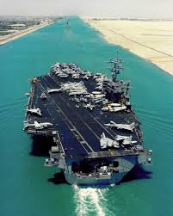
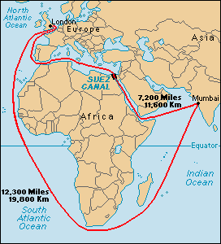
How was he going to do this?

Slide 24
Suez Canal - 1956
Although the shooting had stopped, Korea was no closer to peace than it had been before the armed conflict began.
It was the Suez Crisis of 1956 that brought about the first multinational, voluntary peacekeeping force in the history of international relations.

Slide 25
Background:
Colonel Gamal Abdel Nasser emerged as the leader of Egypt following the Arab defeat in the 1948 Arab-Israeli war.
He had 2 main goals:
To create an independent Egypt free from colonial rule
To destroy the newly formed nation of Israel.

Slide 26
The fastest way to obtain funds was to let the superpowers bid for Egypt’s allegiance.
Egypt needed a modern army to destroy Israel, so Nasser’s long-term solution was to industrialize. (The first requirement was electricity)

Slide 27
He opened negotiations with both superpowers for financing of the project.
In 1955, Nasser signed an arms deal with Czechoslovakia, a Soviet bloc nation.
By 1956, he was ready to conclude an agreement with the USA to help finance and build a $1.3 billion dam at Aswan.

Slide 28
Nasser had successfully maneuvered the Soviets into supplying arms and the Americans into supplying money and technical expertise.

Slide 29
Nationalizing the Suez Canal
Nasser’s brand of non-aligned nationalism. The continued conflict with Israel, which had close ties to the US, also cost Nasser Western support.
Egypt stopped Israeli ships, from using the Suez Canal.
When the United States refused financial and technical aid for the Aswan Dam project, Nasser’s reaction was immediate and dramatic: on July.26, 1956 he seized control of the Suez Canal and turned to the Soviets for help in building the dam.

Slide 30
This Accomplished 2 Goals:
It signaled the end of Egypt’s colonial status.
Provided funds for building the Aswan Dam and modernizing Egypt.

Slide 31
Results:
The British and French were determined to regain their 97% share of the canal’s profit and reassert their status as major powers in the Middle East.
Their military leaders plotted with Israel to recapture the Suez and bring about Nasser’s downfall in the process.

Slide 32
Britain and France devised an elaborate scheme.
Israel was to attack Egypt as part of the ongoing Arab-Israeli dispute.

Slide 33
Britain and France would land troops at the canal zone on the pretence of protecting international shipping during the conflict.
The plan would allow Britain and France to repossess the Suez Canal and enable Israel to expand its territory.
The conspirators miscalculated the reaction of the United States and the world community.

Slide 34
UN Involvement

Slide 35
On October.29, 1956, Israel attacked Egypt.
Britain ordered the Egyptians and Israelis to withdraw from both sides of the Suez Canal.
Egypt refused, but five days after the Israeli attack the fighting had already stopped.
Even so, Anglo-French paratroops and commandos landed as planned, attacking Egyptian positions along the western side of the canal and securing the canal itself.

Slide 36
The invasion stunned the world.
The Soviet Union threatened to launch missiles on Paris and London.
The US was outraged.
The day after the attack, the US introduced a resolution in the Security Council.

Slide 37
It called for Israel to withdraw its troops and for all members to “refrain from the use of force.”
But France and Britain used their vetoes to kill this motion along with a Soviet proposal that the Americans and the Soviets jointly intervene.
Deadlocked, the Suez issue was brought before the General Assembly

Slide 38
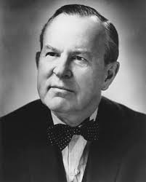
Lester B. Pearson
On November.4 Canada’s UN representative, Lester B. Pearson, proposed that the Anglo-French force in the canal zone be replaced by a PEACEKEEPING FORCE charged with protecting the canal and keeping Israel and Egypt apart…it succeeded.

Slide 39
Lasting Effects…….
The lasting significance of the Suez Crisis was the establishment of an international police force, the UNEF.
Not always the solution for maintaining international peace and security.
The reason is national sovereignty (the right of independent nations to control their territory
Thus, when nations request peacekeeping troops, they come as invited guests of the host nation.

Slide 40
Video Time
Suez Canal Documentary (15:00)

Slide 41
Video Time
Suez Canal Documentary (15:00)

Slide 42
Video Time
Suez Canal Documentary (15:00)

Slide 43
3. Mandela in South Africa:
In 1948, APARTHEID was introduced to South Africa.
This racial policy separated South Africa into classes:
A privileged white ruling class.
An exploited subservient class.
Whites controlled the political, educational and economic institutions for their advantage.

Slide 44
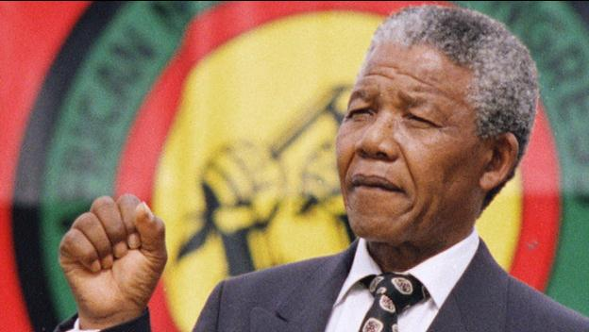
Nelson Mandela: 1918-2013
Nationalist groups such as the AFRICAN NATIONAL CONGRESS (ANC) began using boycotts, strikes, and demonstrations to attack racial discrimination in South Africa.
The South African government responded by arresting ANC leaders such as NELSON MANDELA.
Mandela joined the ANC in 1944 and in the 1950’s he organized non-violent resistance against Apartheid.

Slide 45
Following, the Sharpeville massacre in 1960, Mandela and others abandoned non-violent protest in favor of violent acts.
As a result, Mandela was sentenced to LIFE imprisonment in 1963.
While in prison from 1963 – 1990, Mandela became an international figure with a worldwide following of supporters.

Slide 46
He repeatedly refused offers of freedom in exchange for keeping quiet about Apartheid.
This elevated him to mythical status among black South Africans.
Eventually his fame grew that World leaders and the UN applied political pressure for Mandela’s release.

Slide 47
Musicians, artists and writers championed Mandela’s cause.
Finally in 1990, the South African government facing civil unrest and World pressure released Mandela.
The government pledged reforms to create an equal and democratic South Africa.
In 1994, NELSON MANDELA was elected the 1st Black President of South Africa.

Slide 48
Video Time
Remembering South African Leader Nelson Mandela (18:23)

